Slide 1


Slide 2
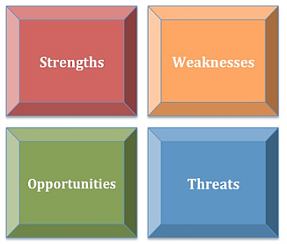
مدیریت استراتژیک فناوری اطلاعات SWOT analysis
تهیه و تنظیم:
رضا میرزاباقری

Slide 3
Content of the lecture
Internal and external factors
Major benefits of SWOT analyses
Types of resources
Creating a SWOT analysis using post harvest losses as a case study

Slide 4
Learning objectives
After this lecture participants will be able to identify internal and external factors that affect strengths, weaknesses, opportunities and threats to activities or operations

Slide 5
SWOT
A widely used framework for organizing and using data and information gained from situation analysis
include both internal and external environments
One of the most effective tools in the analysis of environmental data and information

Slide 6
SWOT description
A SWOT analysis generates information that is helpful in matching an organization’s or a group’s goals, programs, and capacities to the social environment in which they operate
It is an instrument within strategic planning

Slide 7
SWOT
Factors affecting an organization can usually be classified as:
Internal factors
Strengths (S)
Weaknesses (W)
External factors
Opportunities (O)
Threats (T)
Strengths
Weaknesses
Opportunities
Threats

Slide 8
SWOT: internal factors
Strengths
Positive tangible and intangible attributes, internal to an organization. They are within the organization’s control
Weaknesses
Factors that are within an organization’s control that detract from its ability to attain the core goal. In which areas might the organization improve?

Slide 9
SWOT: external factors
Opportunities
External attractive factors that represent the reason for an organization to exist and develop. What opportunities exist in the environment which will propel the organization?
Identify them by their “time frames”
Threats
External factors, beyond an organization’s control, which could place the organization’s mission or operation at risk. The organization may benefit by having contingency plans to address them should they occur
Classify them by their “seriousness” and “probability of occurrence”

Slide 10
For the external factors
Seriousness of Impact
Minimum resources if any
Must plan for
High
Probability of occurrence
Maintain flexibility in plan
Low
Forget it
Low
High
Notes:
This matrix is mostly self explanatory, we just have to remember if we know that if we have factors that have low seriousness of impact and high probability of occurrence then should not focus to hard on them and therefore we put minimum resources if any on them.

Slide 11
Create a plan of action
What steps can you take to:
Capitalize on your strengths
Overcome or minimize your weaknesses
Take advantage of some new opportunities
Respond to the threats
Set goals and objectives, like with any other plan

Slide 12
Major benefits of SWOT analyses
Simplicity
Flexibility
Integration and synthesis
Collaboration
Lower costs

Slide 13
For a productive SWOT analysis
Stay focused. Be specific and avoid grey areas. Keep your swot short and simple. Avoid complexity and over analysis
Collaborate with other functional areas
Examine issues from the customers’/ stakeholders’ perspective
Look for causes, not characteristics
Separate internal issues from external issues

Slide 14
Stay focused
It can be a mistake to complete just one generic SWOT analysis for the entire organization
When we say SWOT analysis, we mean SWOT analyses

Slide 15
Collaborate with other functional areas
Information generated from the SWOT analysis can be shared across functional areas
SWOT analysis can generate communication between managers that ordinarily would not communicate
Creates and environment for creativity and innovation

Slide 16
Examine issues from stakeholders’ perspectives
To do this, the analyst should ask:
What do stakeholders (and non-stakeholders) believe about us as an organization?
What do stakeholders (and non-stakeholders) think of our product quality, service quality, customer service, price, overall value, convenience, and promotional messages in comparison to our competitors?
What is the relative importance of these issues as stakeholders see them?
Taking the stakeholders’ perspective is the cornerstone of a well done SWOT analysis

Slide 17
Look for causes not characteristics
Causes for each issue in a SWOT analysis can often be found in the organization’s and competitors’ resources
Major types of resources:
Financial
Organizational
Intellectual
Informational
Legal
Relational
Human
Reputation

Slide 18
Separate internal and external issues
Failure to understand the difference between internal and external issues is one of the major reasons for a poorly conducted SWOT analysis
Know yourself
Know your customer/stakeholder
Know your competitors
Know your environment

Slide 19
The elements of a SWOT analysis
Strengths and weaknesses
Scale and cost economies
Size and financial resources
Intellectual, legal, and value of reputation
Opportunities and threats
Trends in the competitive environment
Trends in the technological environment
Trends in the socio-cultural environment

Slide 20
SWOT-driven planning
The assessment of strengths and weaknesses should look beyond products, services and resources to examine processes that meet customers’ or stakeholders’ needs
Achieving goals and objectives depends on transforming strengths into capabilities by matching them with opportunities
Weaknesses can be converted into strengths with strategic investment. Threats can be converted into opportunities with the right resources
Weaknesses that cannot be converted become limitations which must be minimized if obvious or meaningful to customers or stakeholders

Slide 21
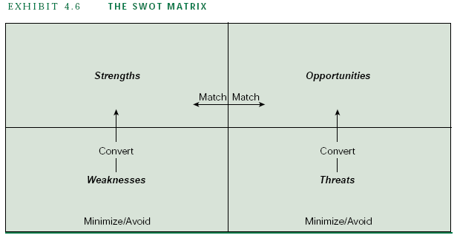
The SWOT matrix

Slide 22
Caution
SWOT analysis can be very subjective. Do not rely too much on it. Two people rarely come up with the same final version of a SWOT
Use it as a guide and not as a prescription

Slide 23


Founded in 1916 in Seattle, Washington
Headquarter in Chicago, USA.
World’s leading aerospace company
The second biggest defense company in the world
With more than 150,000 employees in more than 70 countries
Total company revenues for 2006 were $61.5 billion
Boeing Today

Slide 24
Products
Commercial airliners
Military aircraft
Munitions
Space systems
Computer Services

Slide 25
SWOT ANALYSIS
Strengths
Strong global network
Broad product line that covers most major market niches / R&D development

Slide 26
SWOT ANALYSIS
Weaknesses
A hierarchical, ridged, and semi- autocratic management style, which is a product of its military heritage.
Labour problems.
Dependence on US government and WTO-incompatible subsidies.

Slide 27
SWOT ANALYSIS
Opportunities
New aircraft to gain market share
Increase demand for point to point routes

Slide 28
SWOT ANALYSIS
Threats
Slowdown in the commercial jet market
Uncertain airline industry environment

Slide 29


